Slide 1
Webinar:
The Majority Report:
Supporting the Educational Success of Latino Students in California
Presenter:
Manny Rodriguez, Educational Trust West
Date:
March 29, 2018

Slide 2
Welcome! Ernie Silva Executive Director of External Affairs RAPSA / SIATech Schools To Ask Questions: Please use the chat box for questions. Trouble? Email info@rapsa.org with questions.

Slide 3
The Majority Report
Supporting the Educational Success of Latino Students in California
Manny Rodriguez
Legislative Associate, Policy & Government Relations
The Education Trust—West

Slide 4
Who are the majority?
A sizable majority
1.3 million children under 5
3.3 million K-12 students
1 million college students
Notes:
Latinos are now the largest ethnic group in CA. In 2014, the Latino population outnumbered the White population for the first time. In K-12 schools, they’ve been the largest ethnic group for 2 decades. Today, 1 of every 2 California youth under 25 yrs of age are Latino – making it clear that the future of CA will significantly be shaped by the surging Latino population.

Slide 5
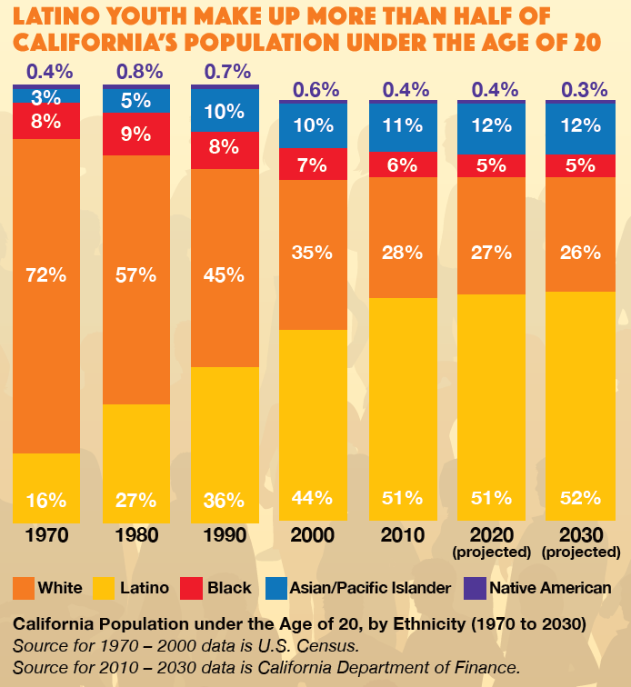
A rapidly growing majority
Notes:
The Latino population has been the fastest growing ethnic group over the past 50 years. In 2014, the Latino population under age 20 grew to over 50% of the population for the first time.

Slide 6
A native born majority
95 percent of California’s Latino youth under the age of 18 were born in the United States
Notes:
Recently, we have heard this constant narrative that a lot of Latinos are illegal and foreigners but the numbers suggest othrwise

Slide 7
A diverse majority
California’s Latino youth do not share a single identity
or a single experience.
They differ by:
Race
Country of origin
Geography within California
Languages spoken
Immigration status
Generational differences

Slide 8
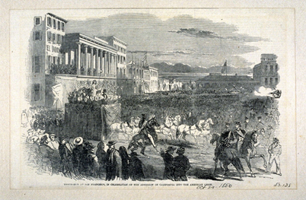
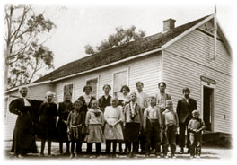
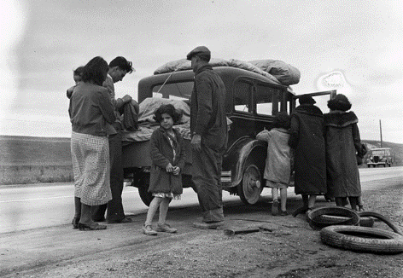
The majority faces a legacy of historical discrimination
California’s state constitution views Mexicans
living in the state as foreigners (1850)
Legitimized school segregation (1863)
Mass deportations in the Mexican Repatriation (1930s)
Propositions with anti-Latino or xenophobic overtones (1990s)
Repeal of DACA (2017)

Slide 9
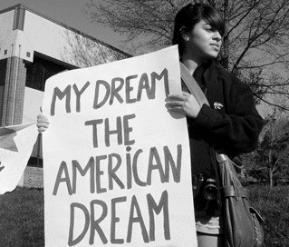
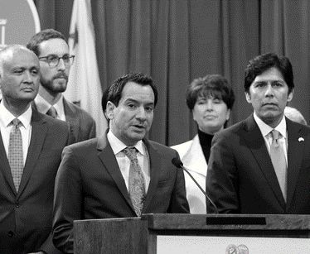
…but also a history of activism
Mendez vs. Westminster strikes down
school segregation (1945)
East LA Walkouts (1968)
California DREAM Act (2011)
“Sanctuary” bills (2017)

Slide 10
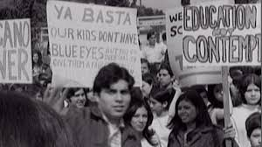
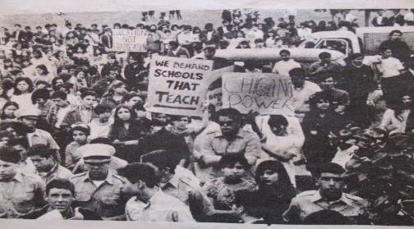
In 1968, thousands of Latino students marched out of their high schools in a protest that would go down in history as the East LA Walkouts.
Notes:
We wanted to historically frame this report with the East LA Walkouts. Back then students were facing many discriminatory practices and inequities such as corporal punishment, overcrowded classes, tracking into vocational studies, and material that disregarded their history and culture.

Slide 11
Half a century later, Latino students still face barriers
Latino students:
Have insufficient access to early childhood education;
Attend the nation’s most segregated schools;
Are often tracked away from college-preparatory coursework;
Are sometimes perceived as less academically capable than their White or Asian peers;
Are less likely to feel connected to their school environment.

Slide 12
Outcomes for Latino students have improved…
The gaps Latino students face in kindergarten readiness and fourth- and eighth-grade achievement are narrowing
High school dropout rates decreased from 27 percent in
1993-94 to 12 percent in 2015-16
The number of Latino students completing Associate’s and Bachelor’s degrees in California has doubled in the past decade

Slide 13
… but change is not fast enough
The increase in college degree attainment has barely made a dent in the percentage of Latino adults with a degree over the same time
Among all ethnic groups, Latino adults are least likely to have a college degree

Slide 14
Turning the Curve Academics
San Jose Unified, San Francisco Unified, and Oakland Unified are among several districts across the state who hold students to higher academic expectations by implementing “A-G for all” policies
Notes:
These schools allow all students to access college prep classes and supporting all students to be college and career ready.

Slide 15
Turning the Curve School Environment
The Puente Project partners with districts works with teachers and counselors to incorporate culturally relevant curriculum and develop meaningful, personal relationships with students, increasing their likelihood of going to college.

Slide 16
Turning the Curve Supporting Individual Needs
Palo Alto Unified, East Side Union, and Gilroy Unified are among the over 100 districts statewide that have issued resolutions committing to support and protect undocumented students
Almost 300 districts across 52 counties award the State Seal of Biliteracy to high school graduates in recognition of bilingual and biliterate proficiency
Kern County leverages their regional Migrant Education Program to provide additional learning time after school, on Saturdays, during the summer, and at home for migrant students

Slide 17
Turning the Curve College Preparation
Riverside County Office of Education created the Riverside County Education Collaborative to pilot college-going interventions with five focus districts and three higher education partners, and then scaled what works county-wide

Slide 18
Turning the Curve College Affordability
Long Beach Unified is among at least two dozen districts which pay for the SAT or ACT college entrance exams for their entire high school junior class.
In 2015-16, Long Beach Unified doubled the number of students taking the SAT.

Slide 19
Turning the Curve Increasing Diversity and Inclusion on Campus
UC Davis has reduced Latino isolation with their Center for Chicanx and Latinx Academic Student Success. Also known as “El Centro”, the center connects students with counselors and peer support groups as well as tutoring, academic workshops, social activities, cultural seminars and faculty advising.

Slide 20
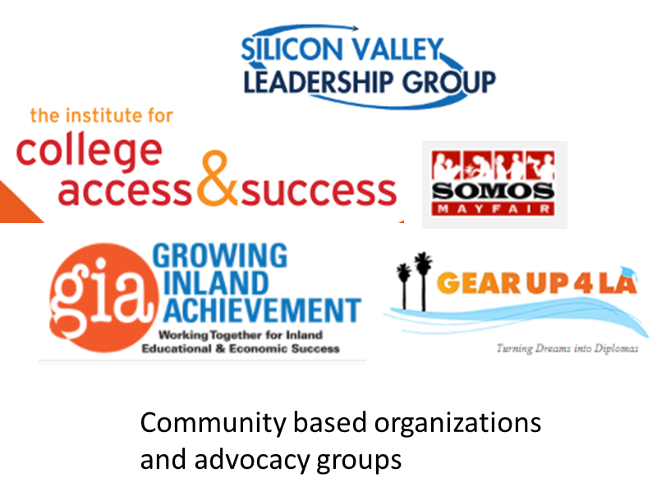
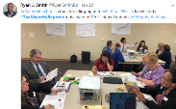
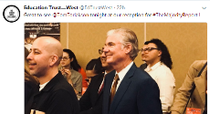
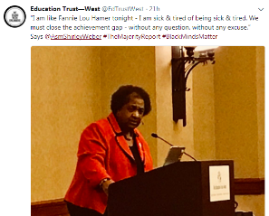
The impact
Regional, county, and district leaders
State policymakers
Notes:
The impact we have seen from TMR has vast and diverse. As mentioned in the description of the webinar there have been numerous media outlets that have asked about the report, its findings, reccomendations that can be adapted for their local area, etc. Additionally, we have had some great engagement by legislators such as Asm. Medina, Bonta, and Weber who are all sponsoring an ethnic studies bill and (3) Asm. Carrillo asked for our assistance in celebrating the 50th anniversary of the 1968 East LA Walkouts where they use TMR to frame the discussion and call to action.

Slide 21
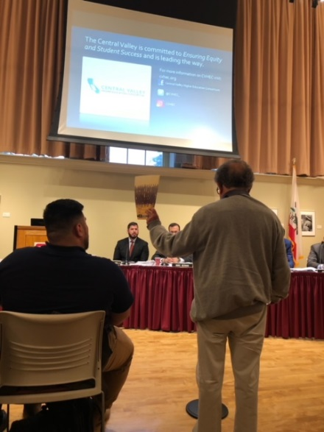
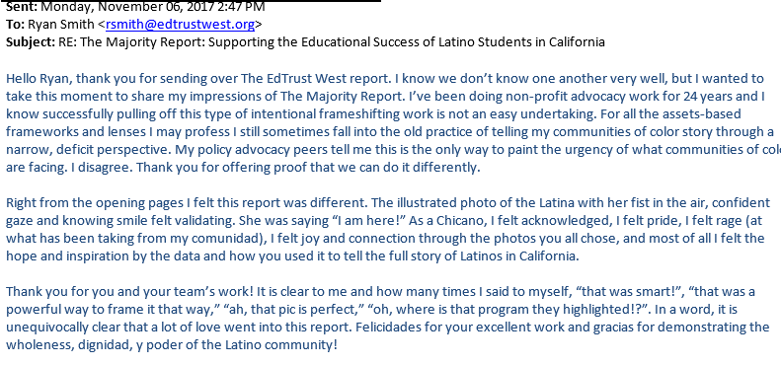
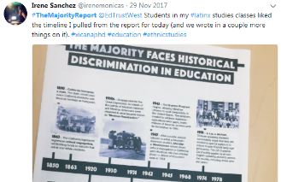
The impact
Parents, community members, educators, and students
Notes:
But most importantly is the data and power this report has given parents, educators and community members. We had a gentleman attended a UC Master Plan meeting in the CV and was waving around our report and using it as a call to action of Latino students in the CV, (2) district office teams have read and discussed the report and what they should do to address the findings in their district, professors for school counselor programs are using TMR to discuss what they need to be thinking about as they start their careers in the education field.

Slide 22
The impact
Call for multiracial movement building

Slide 23
Recommendations
State –
improve and expand the state’s education data systems
strengthen the state’s system of accountability and support
District & Schools –
address educator bias and implement positive disciplinary practices
improve student engagement
Higher Education –
use data to improve student outcomes
streamline remediation
Community Advocates –
build local capacity around educational data
push for equity and transparency in the Local Control and Accountability Plan process
directly engage elected officials, prospective elected officials
and district/school leaders

Slide 24
www.themajorityreport.org
Thank you!
Manny Rodriguez
mrodriguez@edtrustwest.org

Slide 25
RAPSA provides ongoing webinars and other professional development opportunities for leaders serving opportunity youth.
Access this webinar and other webinars at:
www.rapsa.org
Email: ernie.silva@siatech.org
SAVE THE DATE:
AAPF | NOV. 14-16, 2018 | SAN DIEGO

