Slide 1

Webinar:
The Power of Summarization
Presenter:
Sally Brown, PhD.
Date:
May 31, 2019

Slide 2
Welcome!
Charneece Fraticelli
RAPSA Coordinator
RAPSA/SIATech
To Ask Questions during the webinar: Please use the chat box feature.
All other questions please email info@rapsa.org

Slide 3
The Power of Summarization—
The Effects of Explicit Main Idea & Summarization Instruction on Reading Comprehension
Sally A. Brown, PhD
Assistant Professor of Education
College of Idaho

Slide 4
Objectives
Learn the evidence base of using summarization as a strategy to improve students' reading comprehension.
See the effects of the single-case design experiment with AHS students.
Learn how to explicitly teach students to summarize texts.

Slide 5
Background of Problem
NAEP (2015): Only 37% of 12th graders are proficient readers
NRP Report: the Big 5
CCSS emphasize expository text
Literacy demands have increased, but comprehension instruction has not been intensified (CCAAL, 2010; Vaughn & Wanzek (2014).
Notes:
National Assessment of Education Progress-students who have reached the proficiency level when reading grade- level texts
One example--able to integrate & interpret texts to provide main ideas with support from the text
In 2000, under the direction of Congress and the National Institute of Child Health, the NRP published findings about the most effective instructional practices needed to teach young children how to read (Phonemic awareness, phonics, fluency, vocabulary, & comprehension)
Part of these findings include that instruction is explicit and systematic, this should include explicit and systematic reading comprehension for secondary students as well. THIS DOES NOT OFTEN HAPPEN!

Slide 6
Significance of the Topic
Even a smaller percentage of diverse student populations are proficient readers (B = 17%; H = 25%; SWD = 7-11%; NAEP, 2015)
Students with reading difficulties are expected to use grade-level text for learning
AHS: House a disproportionate number of students who have a disability, varied racial groups, and/or live in poverty (Kleiner et al., 2001)
Notes:
…That being said, AHS, AES, and of course at-promise student populations should be the focus of research, particularly academic intervention research, so we can identify the most effective practices for this population of students. We already know they were not successful in a traditional setting..

Slide 7
Purpose
The purpose of the study was to measure the efficacy of explicit instruction in main ideas and summarization to improve reading comprehension of expository text for AHS students.
Notes:
THUS….the purpose of this study is to measure the effectiveness of systematic and explicit instruction in locating or generating main ideas and summarization to specifically improve comprehension of expository text, because remember, secondary students are exposed to difficult text every day of their school careers!

Slide 8
Reading Comprehension
Reading comprehension is
  understanding and learning from text; essence of reading; interaction between reader & text
Successful readers
  set a purpose for reading, self monitor, and apply strategies when understanding breaks down
Teachers can assist students by
  explicitly teaching them how to apply strategies
  providing extended time for guided and independent practice
Notes:
In designing this intervention, we took a deep look at reading comprehension, while identifying what good readers do…
Researchers note that rdg comprehension is arguably the most essential “academic skill” learned in school. If we can read and gain understanding, we can learn from text.
In the literacy field, comprehension is difficult to define. The RAND RSG defines comprehension as the interaction between reader, text, and the activity. Walter Kintsch’s construction-integration model flushes out an even more complex understanding of what happens to the reader as he/she is making meaning form text. (1-surface level; 2- the text base or proposition level; 3- situation model
Students are not going to have us forever, so we need to scaffold instruction and explicitly teach them strategies to improve their reading comp.

Slide 9
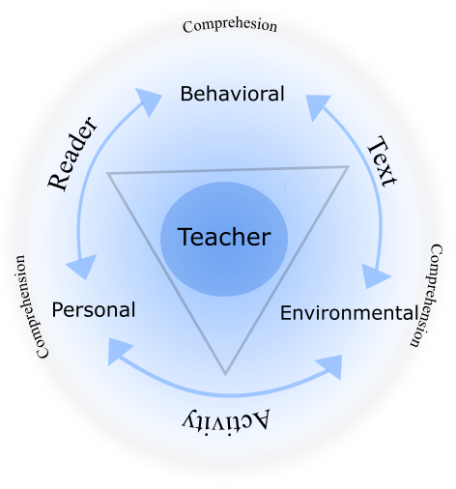
Social Cognitivism and Reading
Figure 1: Social Cognitivism and Reading (Brown, 2017)

Slide 10
What do good comprehenders do?
List according to before, during, and after reading….

Slide 11
What do good comprehenders do?
  Before Reading:
  set purpose
  activate prior knowledge
  make predictions
  During Reading:
  generate questions
  determine main ideas and paraphrase
  make inferences
  use fix-ups to solve comprehension problems
  After Reading:
  summarize

Slide 12
Instruction in Foundational Skills
Main Idea and Summarization:
Research demonstrates that explicit MI and summarization instruction is a high impact strategy (Stevens, Park, & Vaughn, 2016) that can help improve reading comprehension

Slide 13
Explicit Main Idea and Summarization Instruction
Rule-Based (N = 413)
Bean & Steenwyk, 1984
Gajria & Silvia, 1992
Hare & Borchardt, 1984
Reynolds & Perin, 2009
Rinehart et al., 1986
Rogevich & Perin, 2008
Main Idea (N = 82)
Jitendra et al., 1998
Jitendra et al., 2000
Malone & Mastropieri, 1992

Slide 14
Research Design
Multiple-probe design across participants
  Collected a minimum of five data points per participant in baseline to demonstrate a stable or decreasing trend in summarization quality before treatment
  Collected a minimum of seven data points per participant during treatment to demonstrate a change of level and/or an increasing trend.

Slide 15
Primary Research Question
To what extent will explicit instruction in main ideas and summarization increase reading comprehension of below grade-level expository text (6th to 8th grade-level passages/Lexile levels within a range of 820L to 1060L) for students with reading difficulties attending an AHS as measured by
(a) accurate and complete oral summaries, and
(b) generation of big idea topics, identification of key words or phrases, and generation of main idea sentences?

Slide 16
Primary Research Question
To what extent will explicit instruction in main ideas and summarization increase
(a) accuracy of main ideas and summarization definitions, and
(b) identification of high quality models of main ideas and summaries for students with reading difficulties attending an alternative high school as measured by the main idea and summarization knowledge test?

Slide 17
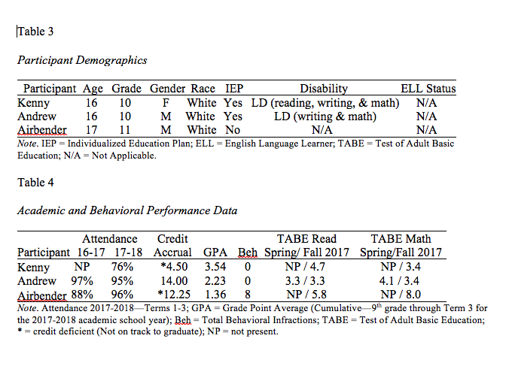

Slide 18
Dependent Variables
Primary Research Questions:
Main Idea and Summarization Knowledge Test
Oral Summaries (below grade level text)
Summarization Guide (SG) (below grade level text)

Slide 19
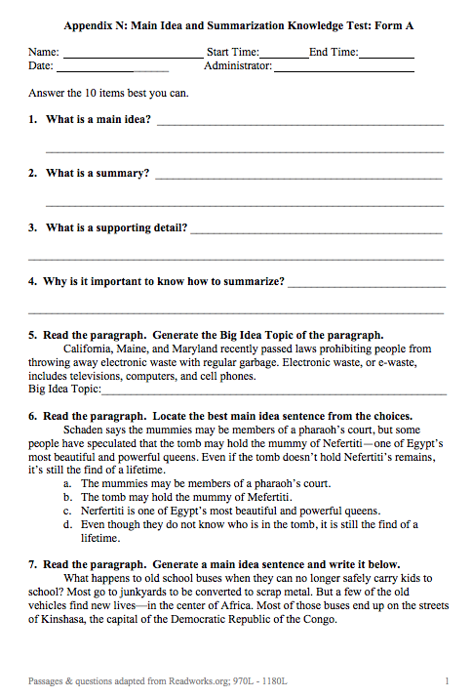
Main Idea & Summarization Knowledge Test

Slide 20
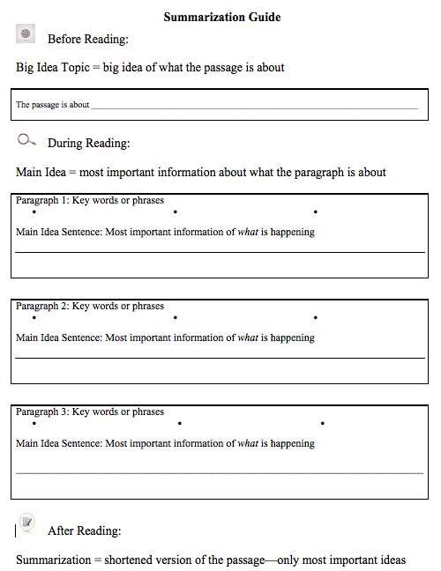
Before Reading
During Reading
After Reading

Slide 21
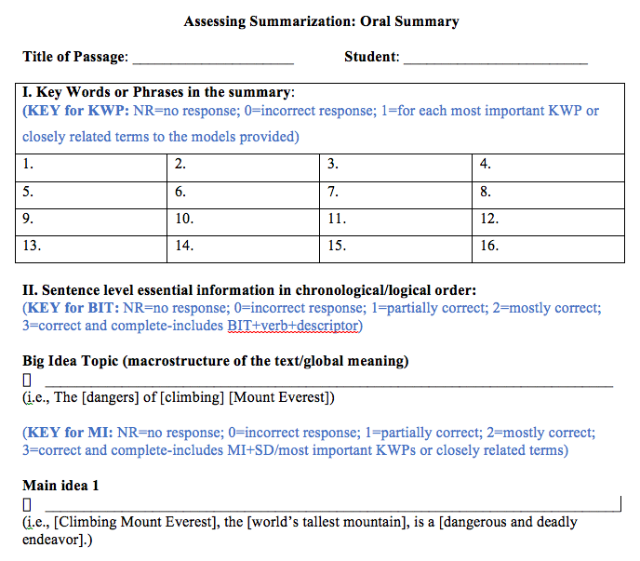
Scoring
Key Words & Phrases
Big Idea Topic, Main Idea Sentences
Summary Score Total

Slide 22
Self-Efficacy Measure
Participants rated their confidence levels in performing certain reading tasks (i.e., How confident are you in your ability to summarize a reading passage?)
  Pretest / Posttest
  Provided information about the perceived level of mastery (Bandura, 2006).

Slide 23
Independent Variable
Explicit main idea and summarization instruction aimed to improve reading comprehension of expository text
Before Reading
  Purpose, importance, terminology,
  Identify the Big Idea Topic
During Reading
  Identify key words and phrases
  Locate or generate main idea sentences
After Reading
  Orally summarize the passage

Slide 24
Fidelity of Implementation
Participant | Date | Instructional Sequence Score | Implementation Quality Score
Kenny | 12/6/2017 | 90% | 100%
Andrew | 1/18/2018 | 97% | 89%
Airbender | 2/22/2018 | 97% | 100%
TOTAL |  | 95% | 96%

Slide 25
Oral Summary Measure:
Kenny, Andrew, & Airbender

Slide 26
Summarization Guide:
Kenny, Andrew, & Airbender

Slide 27
Tau-U: Estimated Effect Sizes
Part | Tau-U | BSL M (SD) | Tx M (SD) | P-Value | 90% CI
Kenny | 0.83 | 26.60 (12.32) | 54.29 (12.88) | 0.0185 | [0.25, 1]
Andrew | 0.90 | 23.67 (12.59) | 47.57 (12.01) | 0.0066 | [0.36, 1]
Airbender | 0.94 | 40.83 (9.65) | 62.22 (6.52) | 0.0027 | [0.43, 1]
Combined | 0.89 | NA | NA | 0 | [0.38, 1]
Oral Summary

Slide 28
Tau-U: Estimated Effect Sizes
Part | Tau-U | BSL M (SD) | Tx M (SD) | P-Value | 90% CI
Kenny | 0.83 | 26.60 (12.32) | 54.29 (12.88) | 0.0185 | [0.25, 1]
Andrew | 0.90 | 23.67 (12.59) | 47.57 (12.01) | 0.0066 | [0.36, 1]
Airbender | 0.94 | 40.83 (9.65) | 62.22 (6.52) | 0.0027 | [0.43, 1]
Combined | 0.89 | NA | NA | 0 | [0.38, 1]
Summarization Guide

Slide 29
Explicit Instruction: Gradual Release Model
I do: Modeling
We do: Guided practice
You do: Independent practice
(Pearson & Gallagher, 1983)
Notes:
*Explicit instruction is further defined in the literature as teaching in small steps, which includes modeling, guided practice, and independent practice (Rosenshine, 1986; Scruggs et al., 2010). Gradual release of responsibility model…..

Slide 30
Defining Terminology
Big Idea Topic (BIT): Includes the big idea of the passage (subject/verb/descriptor); gives us a sense of what the passage is about
Key Words & Phrases (KWP): Most important who or what and what is happening
Main Ideas (MI): Most important information about a person, place, object, or event in a paragraph; complete sentence and contains most important KWPs.

Slide 31
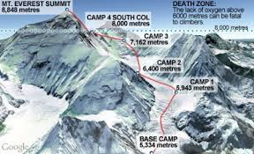
“A Trip to the Top”: What is the Big Idea Topic?
Notes:
*Can provide scaffolding by providing leveled (content) reading materials) and small group instruction.

Slide 32
“A Trip to the Top” (I do)
One ambitious achievement that many people yearn to accomplish is to reach the peak of Mount Everest. However, many people do not realize how dangerous a trip to the top of the world’s tallest mountain truly is. Aspiring climbers often believe that all they need to do to reach the summit of Everest is to have the money to travel to the mountain--located on the border of China and Nepal--and hire a professional guide to assist them. But the mountain poses deadly challenges for even the most experienced mountaineers.

Slide 33
“A Trip to the Top” (I do)
One ambitious achievement that many people yearn to accomplish is to reach the peak of Mount Everest. However, many people do not realize how dangerous a trip to the top of the world’s tallest mountain truly is. Aspiring climbers often believe that all they need to do to reach the summit of Everest is to have the money to travel to the mountain--located on the border of China and Nepal--and hire a professional guide to assist them. But the mountain poses deadly challenges for even the most experienced mountaineers.

Slide 34
Continued “A Trip to the Top” (I do)
KWP:
*reach the peak of Mt. Everest
*dangerous trip
*world’s tallest mountain
*deadly challenges
MI Sentence: Climbing Mount Everest, the world’s tallest mountain, is a dangerous and deadly endeavor.

Slide 35
A Trip to the Top (We do)
The mountain top stands 29,019 feet above sea level. At altitudes higher than 26,000 feet above sea level, there is not enough oxygen in the atmosphere to sustain human life. Brain cells begin to die, blood begins to thicken, and vital organs can shut down without warning. Once climbers reach this “death zone”, it is a race to the top and back down to a safer altitude before sickness sets in or any debilitating injuries occur. There is no way for climbers to prepare for this atmosphere, and even the strongest mountaineers are in grave danger in the death zone.

Slide 36
A Trip to the Top (We do)
The mountain top stands 29,019 feet above sea level. At altitudes higher than 26,000 feet above sea level, there is not enough oxygen in the atmosphere to sustain human life. Brain cells begin to die, blood begins to thicken, and vital organs can shut down without warning. Once climbers reach this “death zone”, it is a race to the top and back down to a safer altitude before sickness sets in or any debilitating injuries occur. There is no way for climbers to prepare for this atmosphere, and even the strongest mountaineers are in grave danger in the death zone.

Slide 37
Continued “A Trip to the Top” (We do)
KWP:
*high altitude, not enough oxygen to sustain life
*debilitating injuries
*no way to prepare
*grave danger in this death zone
MI Sentence: Because of the high altitude and lack of oxygen needed to sustain life, debilitating injuries can occur and there is no way for climbers to prepare for the “death zone”.

Slide 38
Continued “A Trip to the Top” (You do)
Determined climbers first began trying to reach Everest’s peak in 1922. Since then, over 200 people have died on the mountain. Some climbers have lost limbs due to frostbite or untreated injuries sustained during the summit. Those interested in ascending Everest should take plenty of time to consider the many inherent risks that come with climbing the mountain.

Slide 39
Continued “A Trip to the Top”
(You do)
Determined climbers first began trying to reach Everest’s peak in 1922. Since then, over 200 people have died on the mountain. Some climbers have lost limbs due to frostbite or untreated injuries sustained during the summit. Those interested in ascending Everest should take plenty of time to consider the many inherent risks that come with climbing the mountain.

Slide 40
Continued “A Trip to the Top”
(We do)
KWP:
*200 people died
*untreated injuries sustained
*climbers should consider risks
MI Sentence: Many people die trying to climb Mount Everest, and climbers should take time to consider all of the risks before making an attempt.

Slide 41
After Reading Activities: Summarize!
1- Edit the BIT as needed.
2- Using the SG, generate a sentence using the BIG.
3- Combine the most important KWP and main ideas in a logical way
4- Include details that support the MI.
4- Include only essential information.
5- Generate a summary that represents the passage.

Slide 42
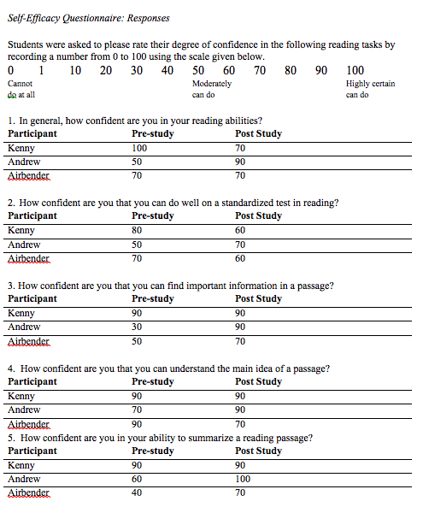
Self-Efficacy

Slide 43
Social Validity
Question | Kenny | Andrew | Airbender
The summarization strategy helped me be a better reader. | 4 | 5 | 5
I can explain the definition of main ideas and summaries to a friend. | 5 | 5 | 5
Summarization helped me to understand difficult passages. | 4.5 | 4 | 5
I liked using this strategy. | 4 | 5 | 5

Slide 44
Contact Information
Sally A. Brown, PhD
Assistant Professor of Education
Department of Education
College of Idaho
sbrown@collegeofidaho.edu
Office Number: 208-459-5109
Dissertation Study: Brown, S. A. (2018). The Effects of Explicit Main Idea and Summarization Instruction on Reading Comprehension of Expository Text for Alternative High School Students. Available on Digital Commons@USU

Slide 45
RAPSA provides ongoing webinars and other professional development opportunities for leaders serving opportunity youth.
To access this webinar and past webinars go to:
www.rapsa.org
Email: ernie.silva@siatech.org
for inquires on AAPF2019 or future webinar suggestions
SAVE THE DATE:
AAPF | NOV. 13-15,2019| SAN DIEGO

